Slide 1

Department of Computer Science Kendriya Vidyalaya No.1,Dehu Road,Pune

Slide 2
CERTIFICATE
This is to certify that ‘Swati’ of class XII-Science ‘A’ has prepared the report on the project entitled ‘Time table’. The report is the result of her efforts and endeavors.
The report is found worthy of acceptance as final project report for the subject Computer Science of class XII. She has prepared the report under my guidance.
Teacher’s Principal External Date
signature Examiner

Slide 3
Acknowledgement
I would like to convey my heartfelt thanks to ‘Mrs. Uma Tiwari’, my computer science teacher who guided me through the project and also gives valuable suggestions and guided me in completion of the project.
She helped me to understand and remember important details that were necessary for for the project.
My project has been a great success only because of her guidance and support.
Swati
XII-SCIENCE ‘A’

Slide 4
Contents
System used
About Python
About MySQL & Connectivity
Introduction Of project
Flow Chart Of Project
Algorithm Of Project
Code of project
Bibliography

Slide 5
System used
For Anaconda(Spyder) And MySQL
Operating System : Windows 10
Processor : Amd Ryzen7
Minimum Memory Requirement :2 GB RAM,1 GB Hard Drive(recommended)
Screen and colour resolution :1980 X 1080 resolution 16
Bit Colour
Internet Access Recommended
(only for installation & Connectivity)

Slide 6
About Python
Python is an interpreted, high-level, general purpose programming language. Created by Guido van Rossum and first released in 1991, Python’s design philosophy emphasizes code readability with its notable use of significant whitespace. Its language constructs and object-oriented approach aim to help programmers write clear, logical code for small and large scale projects.
Python is meant to be an easily readable language. Its formatting is visually uncluttered, and it often uses English keywords where other languages use punctuation. It has fewer syntactic exceptions and special cases than C or Pascal.

Slide 7
About MySQL & Connectivity
MySQL is an open source relational database management system. It is developed by Oracle Corporation. Its name is a combination of “My”, the name of co-founder Michael Widenius’s daughter, and “SQL”, the abbreviation for Structured Query Language.
It is downloadable from site www.mysql.org.
MySQL is a fast, reliable ,scalable alternative to many of the commercial RDBMSs available today.
In order to connect MySQL to python, we ned a tool called MySQL connector. After downloading and installing it we can connect the python environment with the database.
And we can work in the python environment and the data will be inserted in the database in the background.

Slide 8
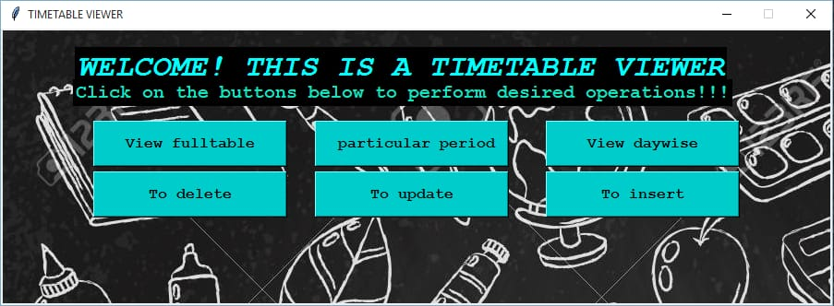
Front end

Slide 9
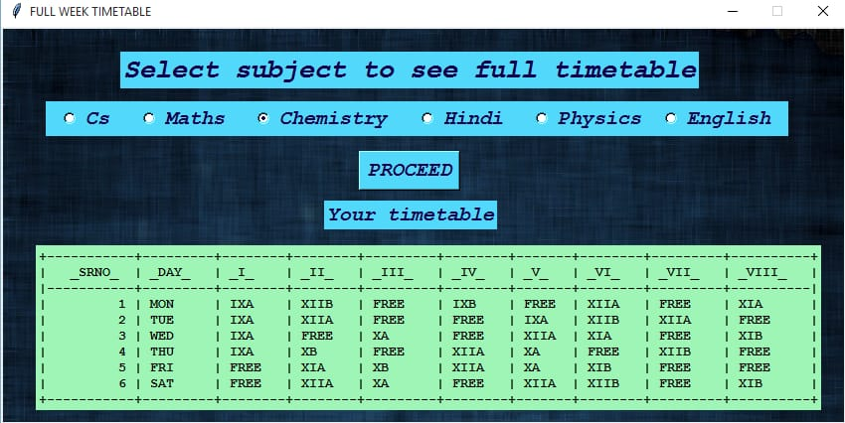

Slide 10
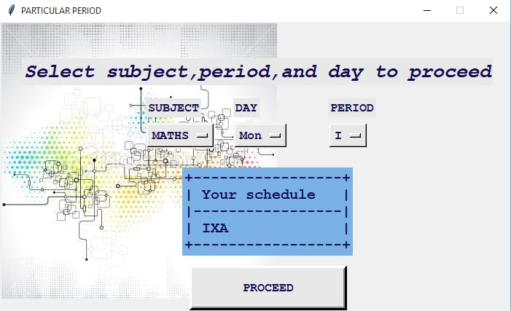

Slide 11
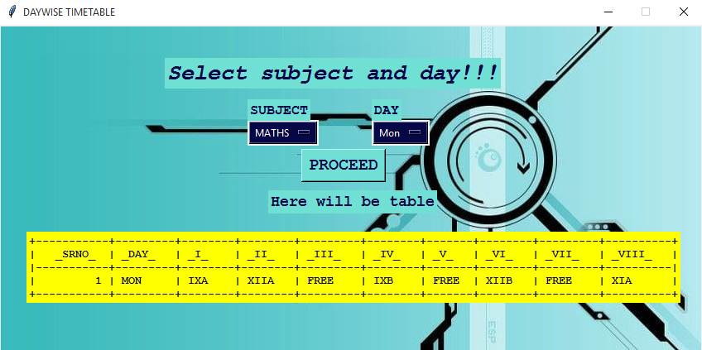

Slide 12
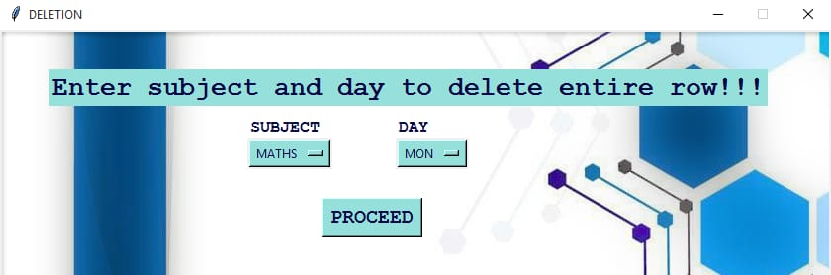

Slide 13
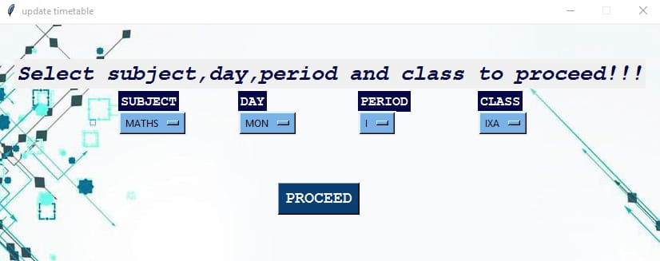

Slide 14
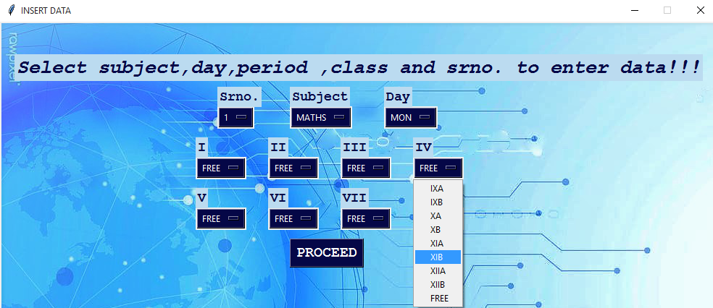

Slide 15
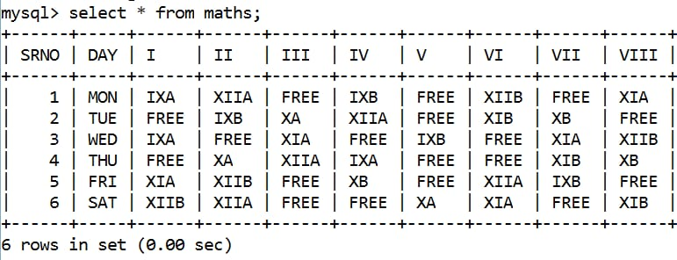
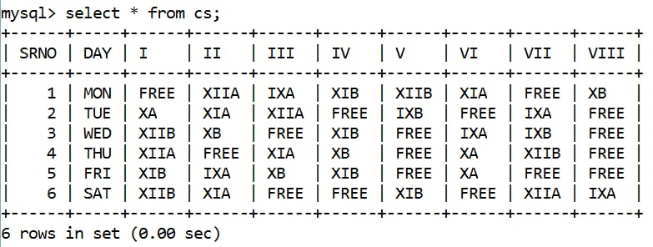
Back end tables

Slide 16
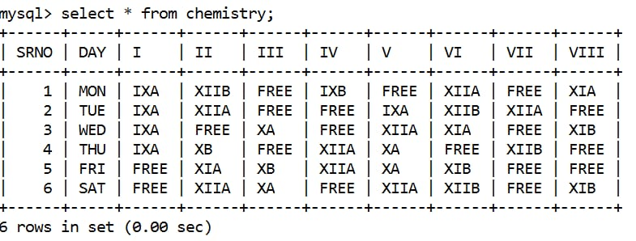
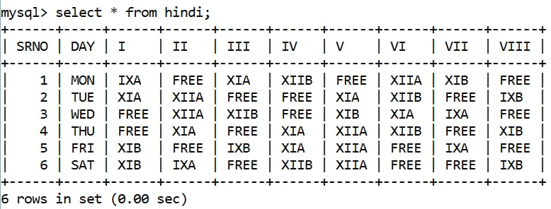

Slide 17
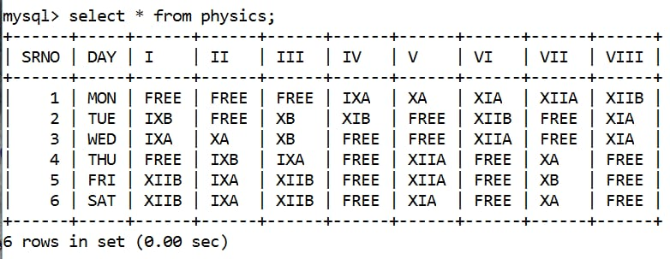
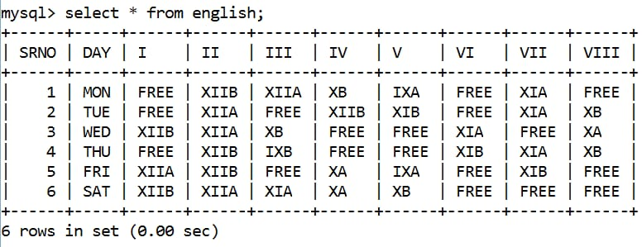

Slide 18
Introduction Of project
“Time-table” it is an important part of everyday life, especially in fields like schools and colleges. It is hard to remember each occurring period therefore timetables are necessary and need to be carried by both teachers and students. This program will help you to save your timetable in databases and very easy to access any time. Through our program you will be able to insert,delete and access your program in just few chicks.

Slide 19
Flow Chart Of Project
Timetable
Back end
Front-end
Connecting front-end and back-end
Sql
Python
Main window
Table creation
Functions creation
Sub windows
Connection with python
Accessing functions

Slide 20
Modules And Packages Used
Tkinter
Tabulate
Pillow
MySQL connector/ pymysql

Slide 21
Algorithm Of Project
For Back End :
⦁ Create a database with a suitable name with the required tables in it.
⦁ Create the required number of columns for each and every detail.
⦁ Connect the python program with the MySQL.
Make important function for use.
Save the program as the package.

Slide 22
To Create Front Environment:
⦁ Create a frame using tkinter library
⦁ Create buttons and text boxes
⦁ Name the labels and the main title for project
⦁ Create the buttons required and a display window aside to show entered details
⦁ Create the functions required to operate the buttons and to display the details

Slide 23
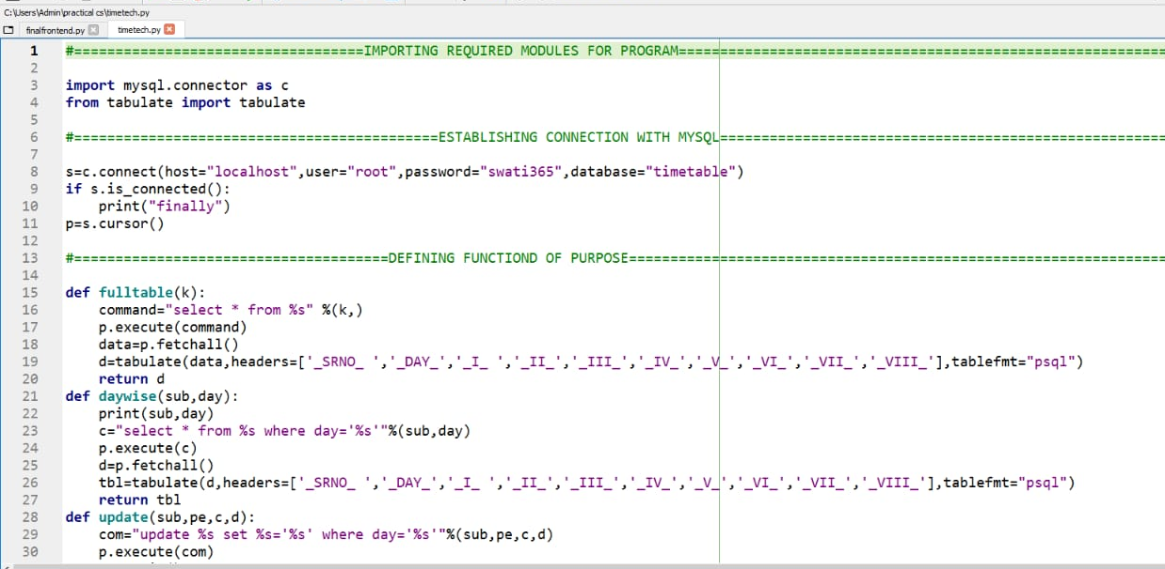
Code of the project

Slide 24
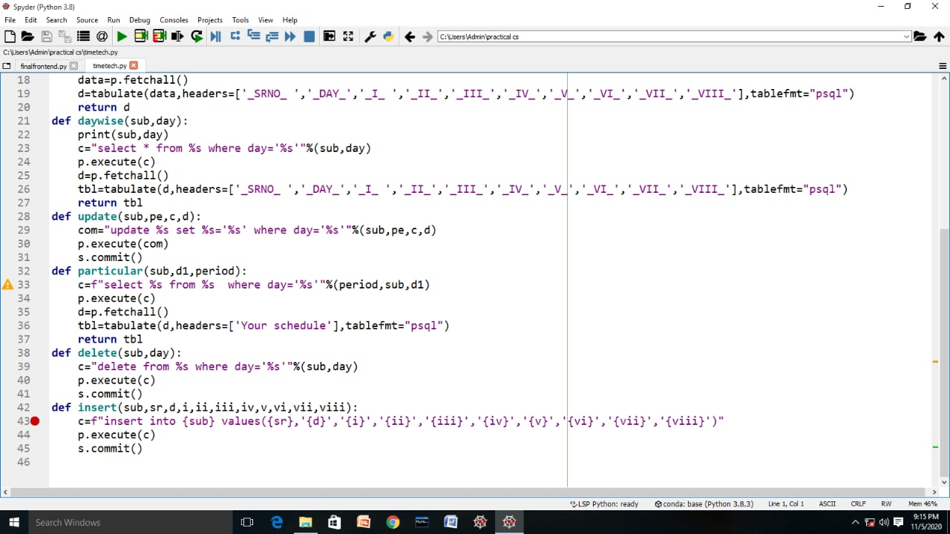

Slide 25
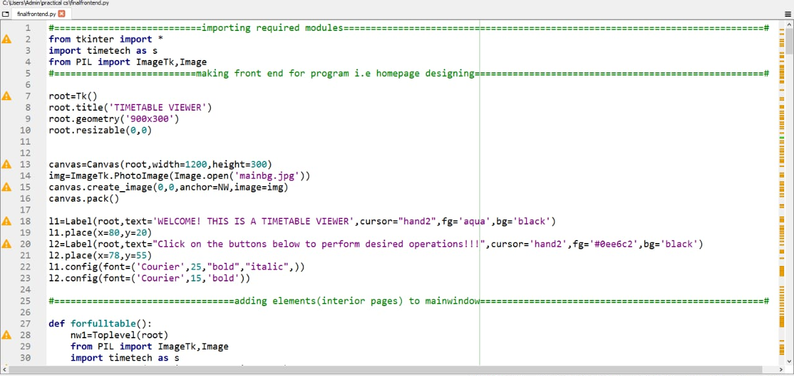
Front end code

Slide 26
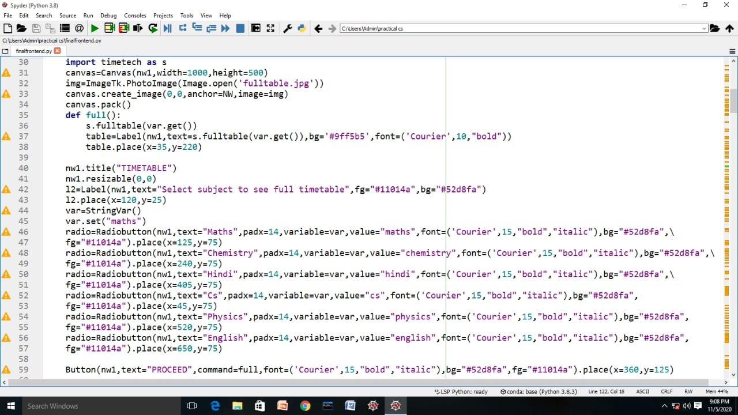

Slide 27
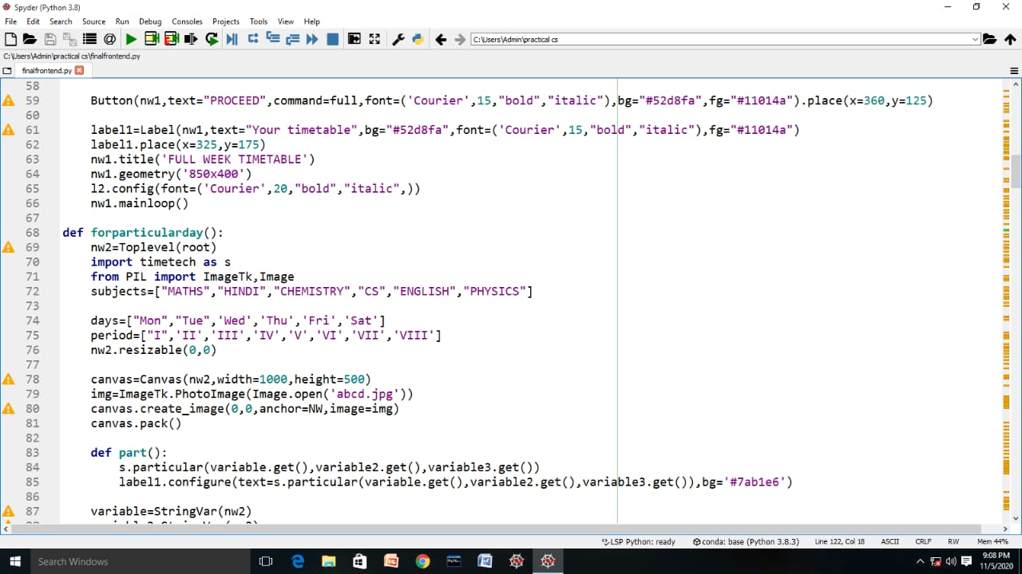

Slide 28
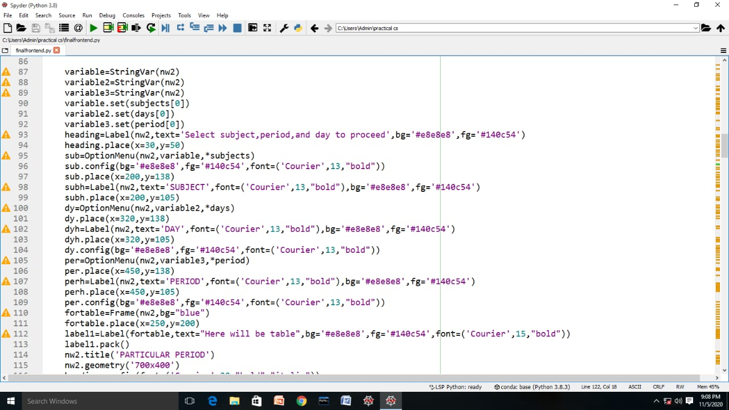

Slide 29
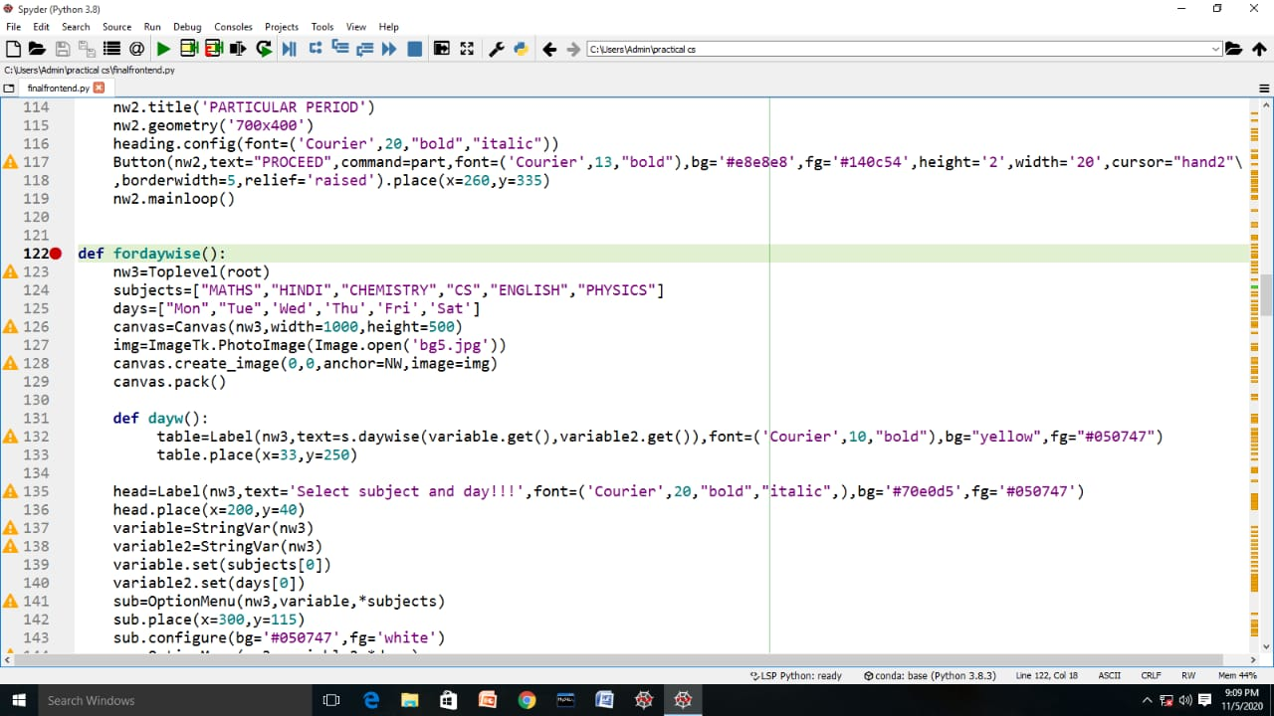

Slide 30
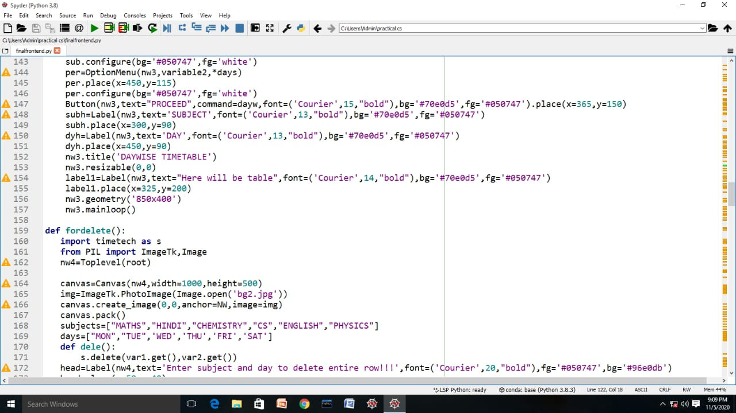

Slide 31
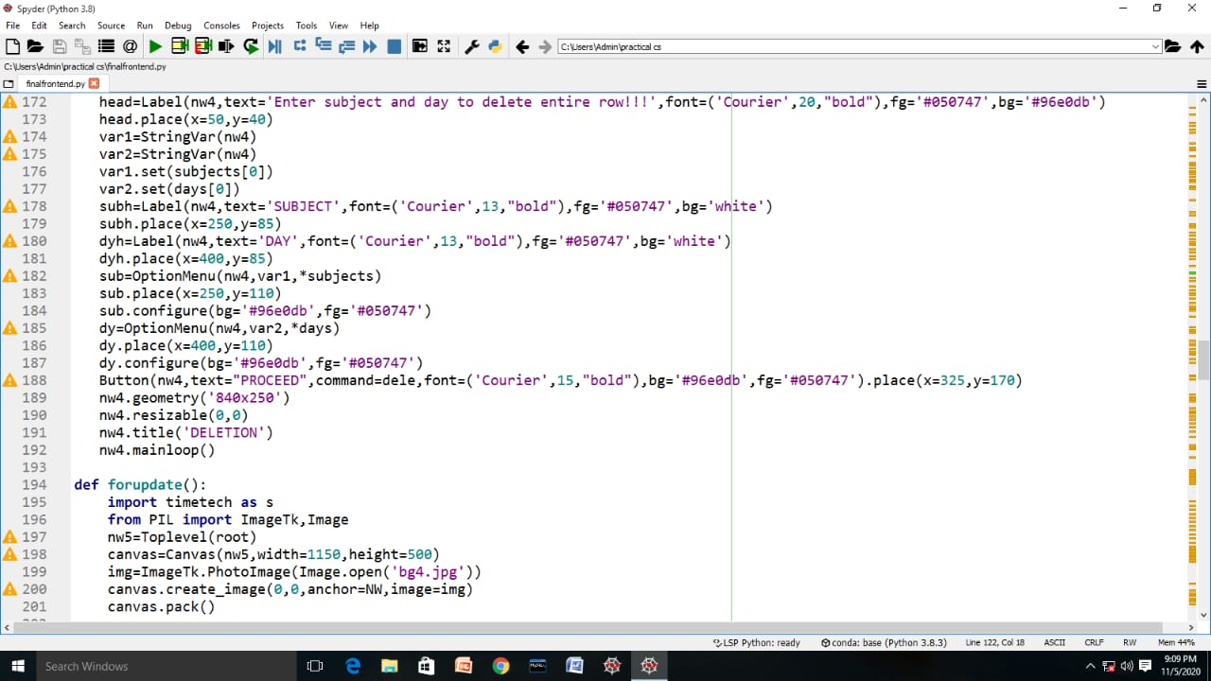

Slide 32
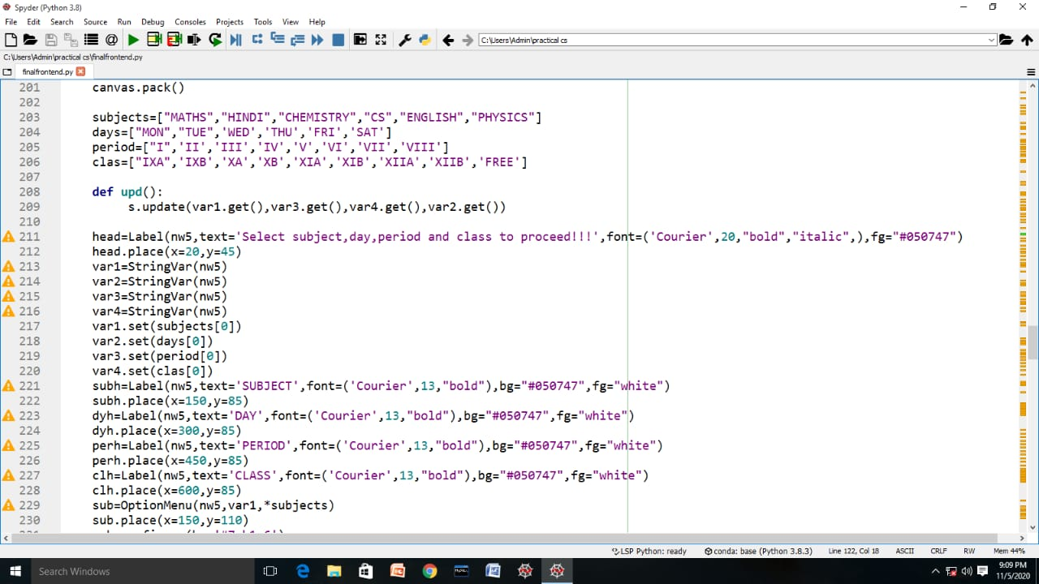

Slide 33
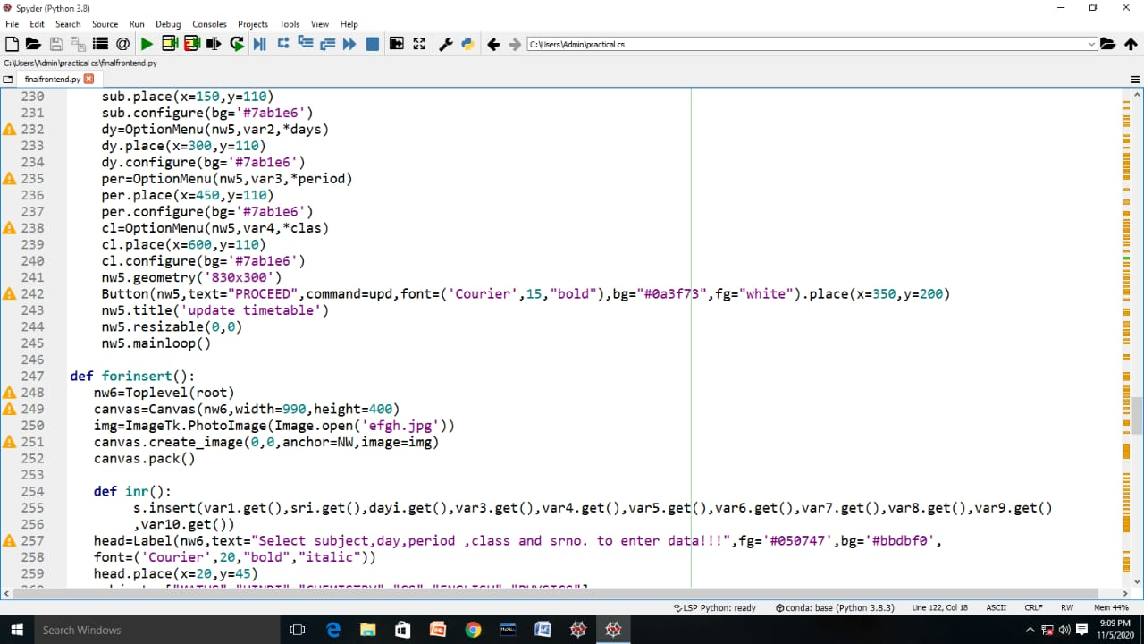

Slide 34
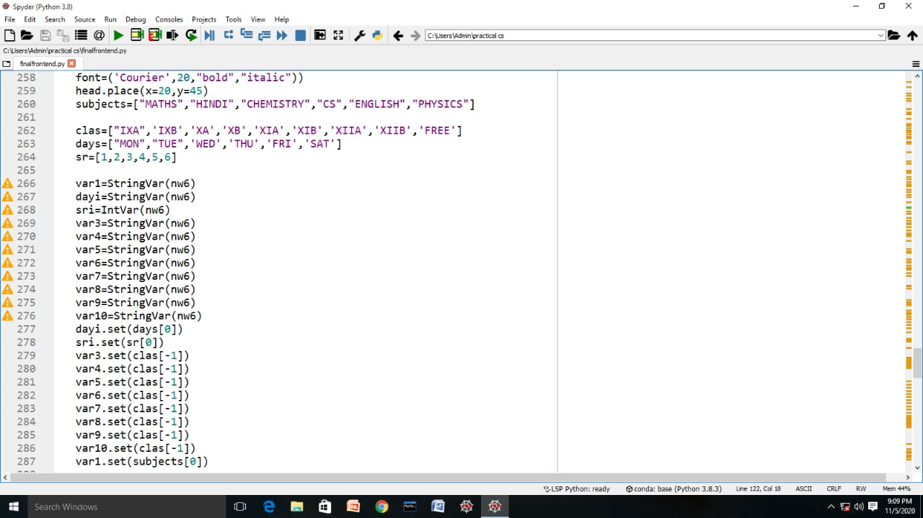

Slide 35
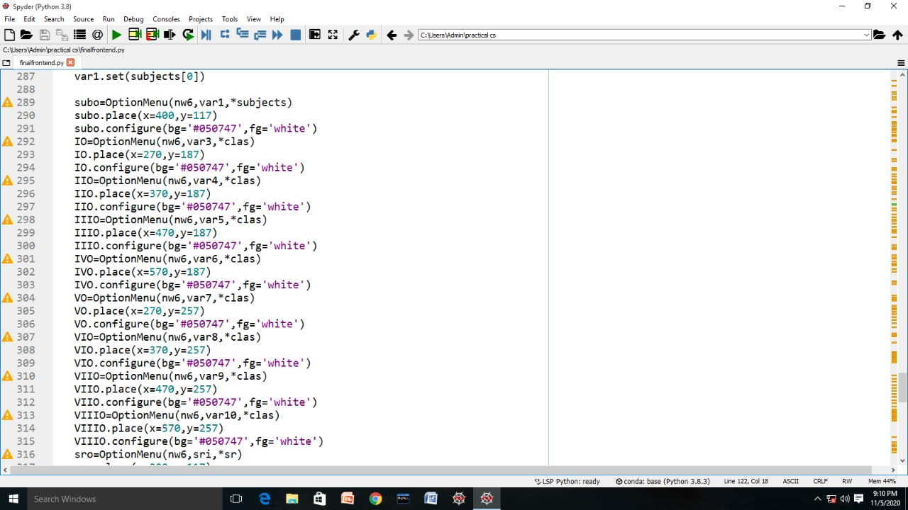

Slide 36
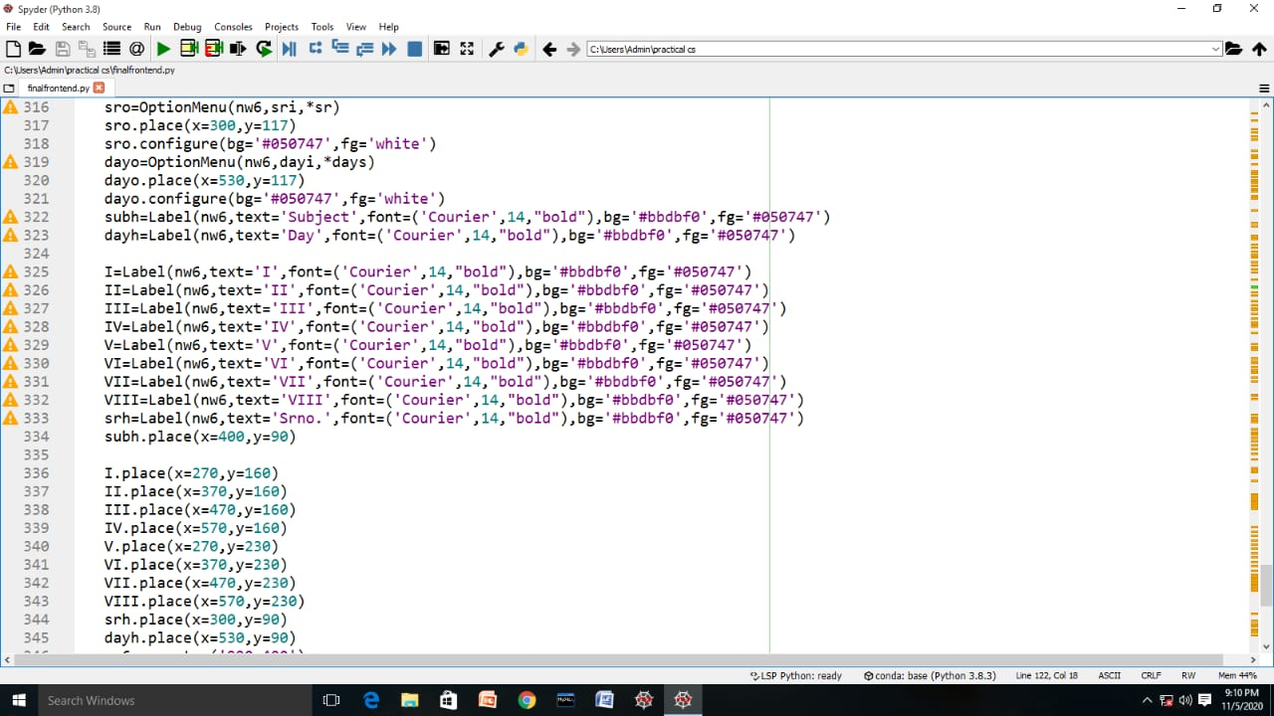

Slide 37
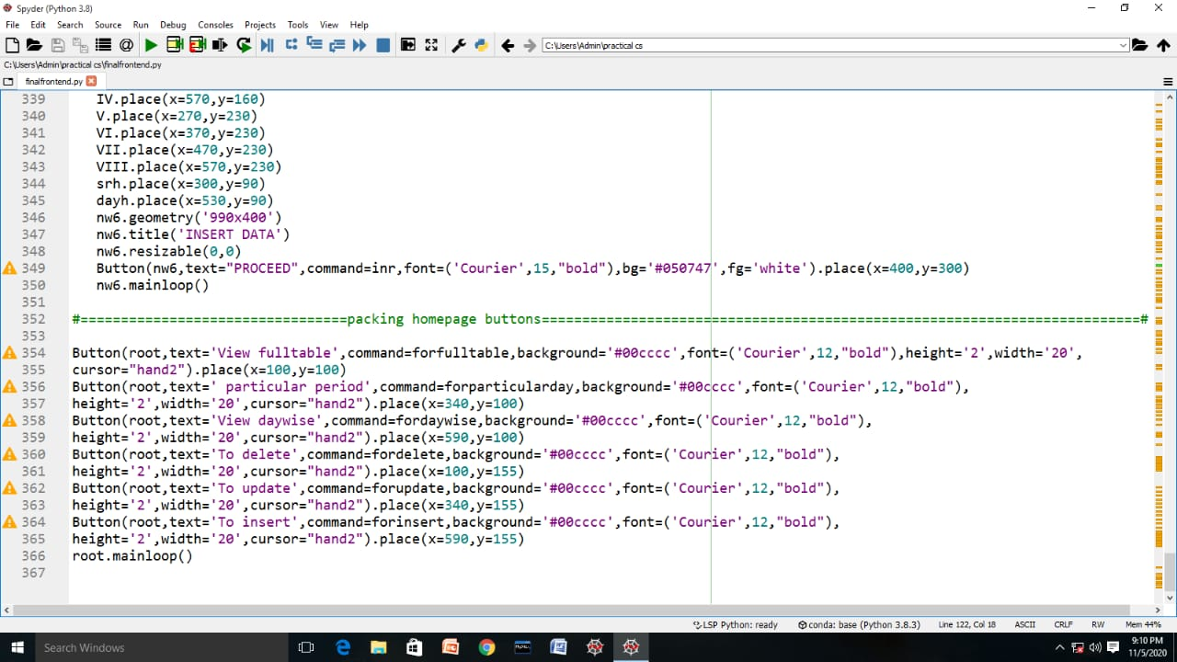

Slide 38
Bibliography
Python Textbook by Sumita Arora
Stack overflow.com
www.w3schools.com
geekforgeeks.com

Slide 39


